Slide 1

Views and Stored Procedures
Version 1.5

Slide 2
Overview
Views
Using views
Stored procedures
Using stored procedures

Slide 3
OBJECTIVES
At the end of this module you will be able to:
use a predefined view
create a simple view
use a predefined stored procedure

Slide 4
Views

Slide 5
Views
Stored select statements
Act just like tables
Benefits:
Reusable
Simplify complex queries
Limit access to sensitive data
Notes:
As you might have realised by now, queries can quickly become extremely complex and hard to follow once we start joining tables together. To simplify matters, select statements can be stored in the database as views which we can then query as though they were tables.
Some points to note about views:
They do not take up space – when we use a view in the FROM clause of a SELECT statement, SQL looks up the view definition and uses that as the basis for the selection.
There is very little overhead to using views, just the time taken to look up the view’s definition. SQL does not go and get all of the rows and columns selected by the view and then apply any WHERE clauses. The final query that is executed is a combination of the view’s definition and our select statement.
Views can also be used to control access to sensitive data. Whilst it is possible for database administrators (“DBAs”) to restrict access on a column-by-column and user-by-user basis, it is easier (both to set up and to maintain) to restrict access to tables and allow access to views which don’t include the sensitive data.
A full discussion of database security is beyond the scope of this course.

Slide 6
Using views

Slide 7
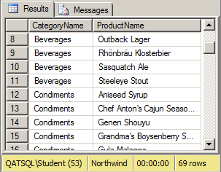
Using views
SELECT CategoryName, ProductName FROM dbo.[Products by Category] ORDER BY CategoryName, ProductName
SELECT CategoryName, ProductName FROM dbo.Products AS p JOIN dbo.Categories AS c ON p.CategoryID = c.CategoryID WHERE p.Discontinued = 0 ORDER BY CategoryName, ProductName
Notes:
In the example on the slide, we are using a view that already exists in the Northwind database, called “Products by Category”, that joins the Products and Categories tables and includes a WHERE clause to get rid of discontinued products. Our second FROM clause is much simpler but we still need an ORDER BY clause as view definitions can not include sorting*. Remember sorting is the last thing to occur, so we have to know what records to get before doing the sort. If the view definition had the ORDER BY, but the user’s SELECT statement had the WHERE clause, SQL could potentially be doing a whole lot of sorting before realising that it didn’t need to return any records!
The second query is a lot simpler, and would be even more so if the view being referenced didn’t have spaces in its name.
One thing that we can’t do in a view is ask for any columns not in the view’s select list. For example the “Products by Category” view doesn’t include ProductIDs or CategoryIDs, so we can’t ask for them in the second query but we could have in the first one.
The first query shows the sql query and the second has the same saved as a view.
*Strictly speaking, it is possible under some circumstances to include ORDER BY in a view. But definitely not in this case!
Order by cannot be placed in a view only in a query referencing a view.
CREATE VIEW [Products by Category] AS

Slide 8
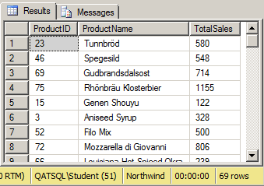
Using views (2)
SELECT p.ProductID, p.ProductName, SUM(Quantity) AS TotalSales FROM dbo.[Current Product List] AS p JOIN dbo.[Order Details] AS od ON p.ProductID = od.ProductID GROUP BY p.ProductID, p.ProductName
Notes:
The example on the slide JOINs the Order Details table to a view called “Current Product List”, which is saving us a single SQL clause, namely:
WHERE Products.Discontinued = 0
It serves to illustrate that you can JOIN tables to views, or views to views, or views to tables as well.

Slide 9
Stored procedures

Slide 10
Stored procedures
Set of SQL statements stored in the database
Can accept parameters
Can return records
Can modify the database
Can perform complex logic
Notes:
Views are always and only stored SELECT statements.
Stored procedures, also known as “stored procs” (pronounced to rhyme with “frocks”) or “SPs” are any stored set of SQL statements, which could be a query or could be some complex database update code.
SPs can accept parameters, which for a proc that returns records could be used to adjust the WHERE clause or for a proc that adds a new record to a table could be a list of the values to add.
Since SQL 2005 stored procedures can also be created using managed code such as C#
CREATE PROCEDURE PremiumProducts
AS
SELECT ProductID
FROM dbo.[Order Details]
GROUP BY ProductID
HAVING SUM(Quantity) > 700
UNION
SELECTProductID
FROM dbo.Products
WHERE UnitPrice > 100
GO;
EXEC PremiumProducts;

Slide 11
Using stored procedures

Slide 12
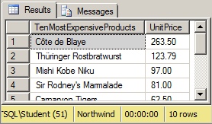
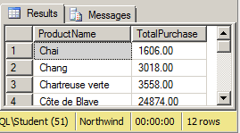
Using stored procedures
EXECUTE <<procedure-name>>
EXEC <<procedure-name>> param1, …, paramN
EXEC dbo.[Ten Most Expensive Products]
EXEC dbo.SalesByCategory ‘Beverages’, 1996
Notes:
We use the EXECUTE statement to call a stored procedure. The EXECUTE can be and often is shortened to EXEC. This is then followed by the name of the SP and then any parameters that need to be passed to it.
In the first example on the slide, we are executing one of the procs in the Northwind database that effectively runs the following query:
SELECT TOP 10 ProductName, UnitPrice FROM Products ORDER BY UnitPrice DESC
In the second example on the slide, we are executing another of the sample procs. This one calculates the annual sales for products in a certain category, so we need to tell it which category we are interested in and also which year. We could get the same results by executing the proc in the following way:
EXEC dbo.SalesByCategory @CategoryName = ‘Beverages’, @OrdYear = 1996
The author of the proc has also defined a default value for the “OrdYear” parameter of 1998, so we could execute it:
EXEC dbo.SalesByCategory @CategoryName = ‘Beverages’
and get the sales for the beverages category for the year 1998

Slide 13
HANDS-ON LAB
Using views
Creating views
Using stored procedures

Slide 14
Review
Views
Using views
Stored procedures
Using stored procedures

